Slide 1
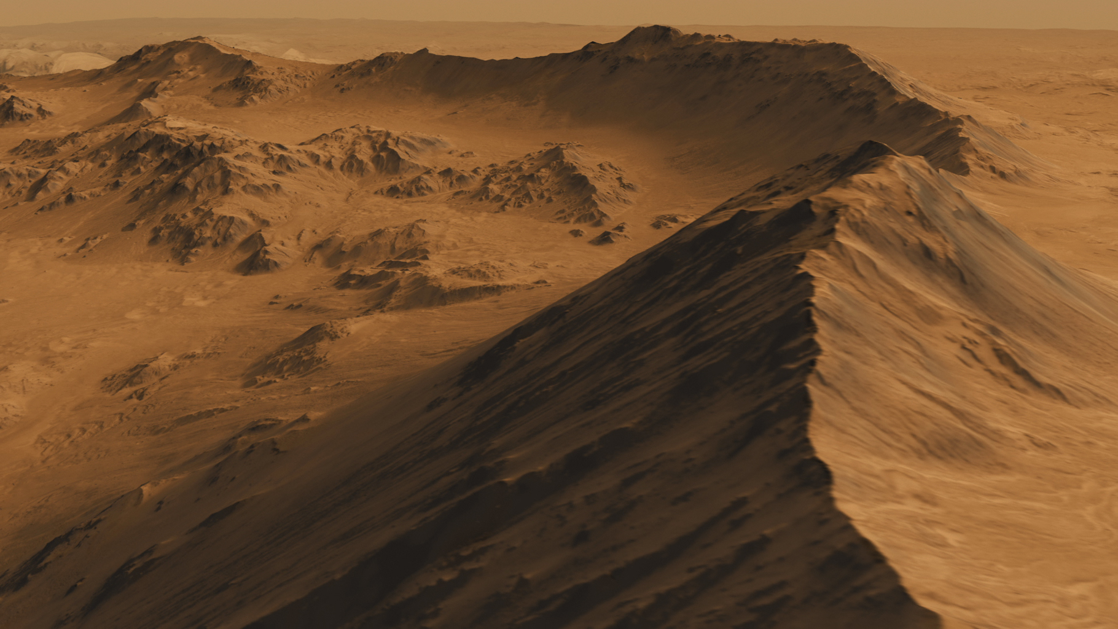
Polyhack 2019
Source: NASA

Slide 2
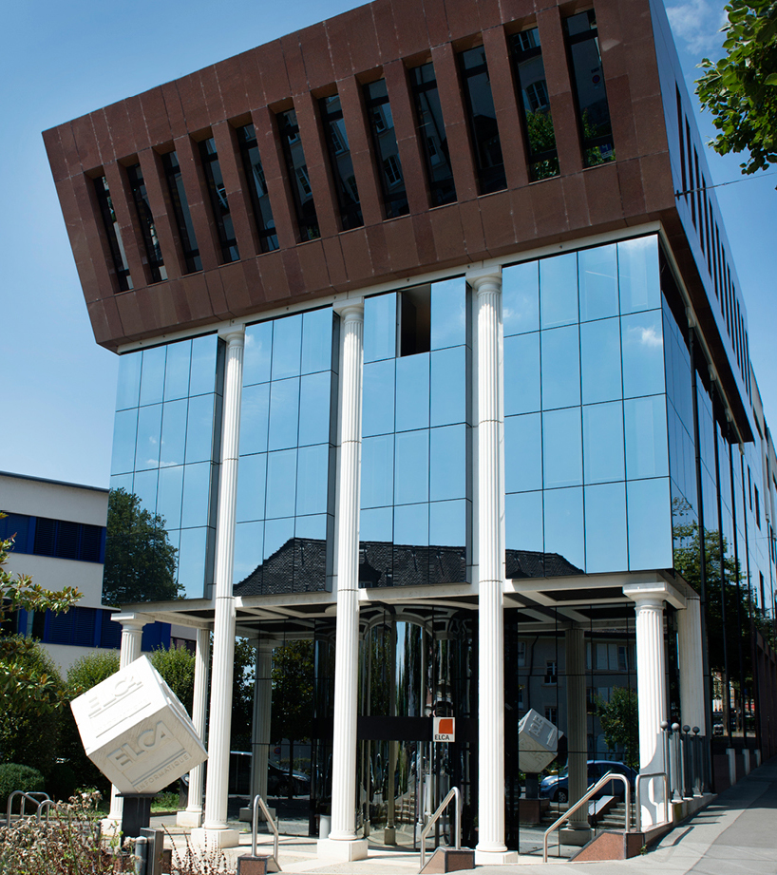
WHO WE ARE
Our core business
We are one of the Swiss main independent IT Services Companies for Software Development, System Integration and Business Consulting

Slide 3
WHO WE ARE
Organisation and diverse team
Over 1100 skilled employees
with an average age of 38
years
from more than 30 countries
in worldwide 11 offices
working on more than 100 projects every year
for 12 different industries

Slide 4
The Team
Roman Bäriswyl

Slide 5
Briefing
Astronauts went missing during a Mars expedition.
Notes:
Story: Two twin Astronauts were sent to Mars to look for the ideal homebase to start the colonization of Mars. The last message we received were: «Hot spring detected. We are moving in.» 24 hours passed without response and now it is time to start the investigation of our missing astronauts.

Slide 6
Mission
Analyze your surroundings
Navigate through unknown terrain
Find the missing astronauts

Slide 7
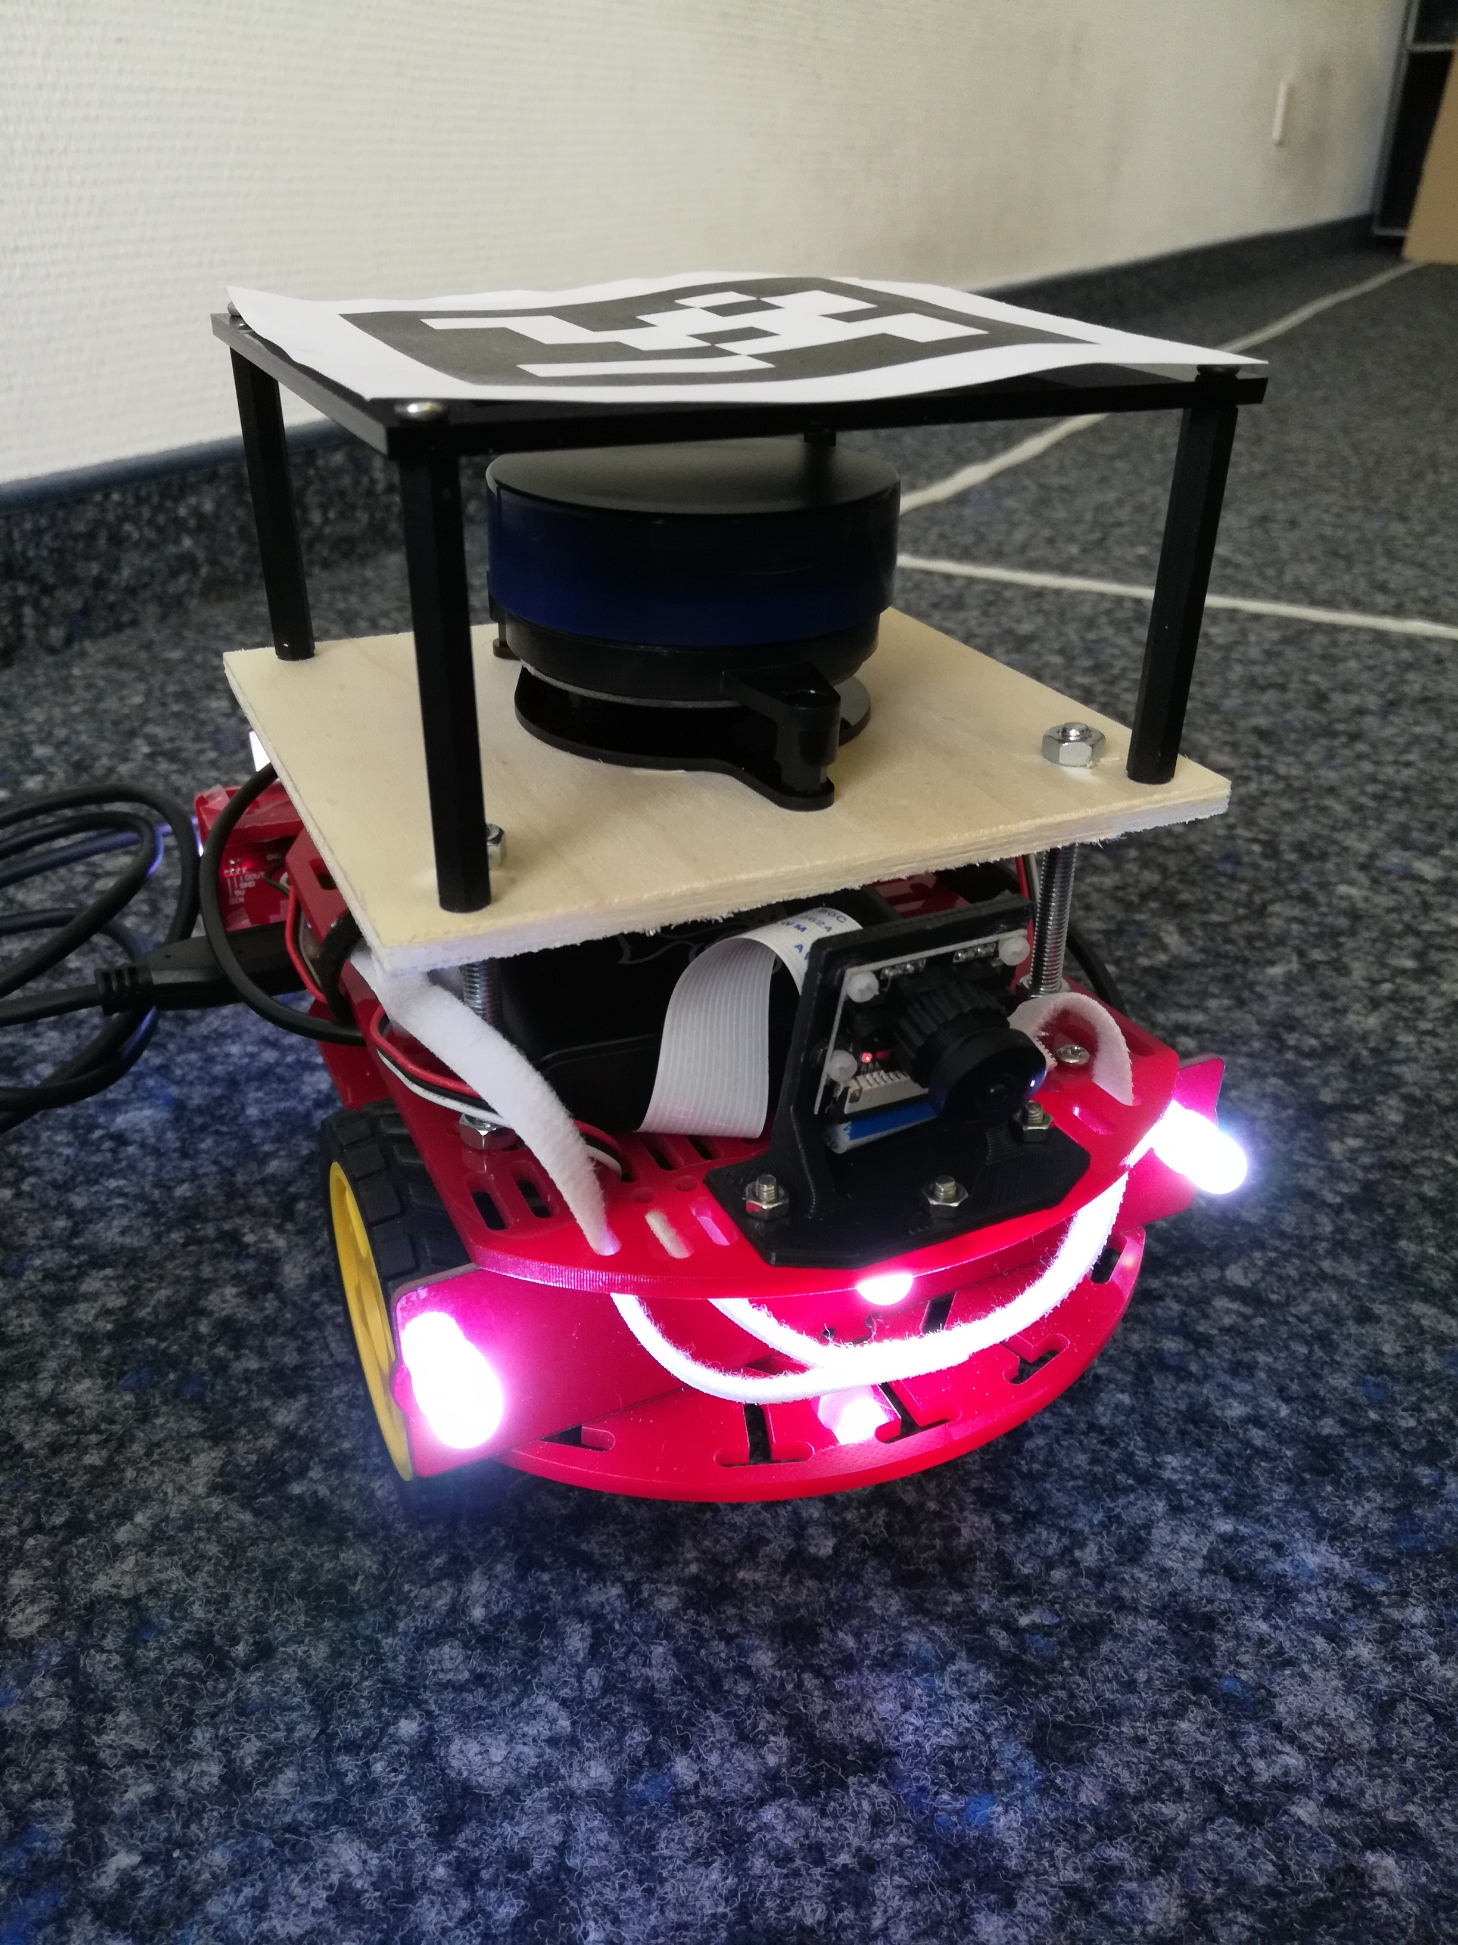
Equipment
Duckietown - Duckiebot
Shared LIDAR
REST API to get started

Slide 8


Join us!

